Slide 1
JOB AUTOMATION
GUILLERMO GAMEZ

Slide 2
OPERATIONS SPECIALIST - OEP/ACOSTA
What is Acosta ?
Marketing Agency for Food Packaged goods dedicated to gain market share
What is OEP ?
Sub Branch of Acosta dedicated to Amazon Business Only
Operation Specialist Duties
Forecasting Sales
Forecasting Unit Demand
Inventory Control
Route Shipments
Edit/Create Documents

Slide 3
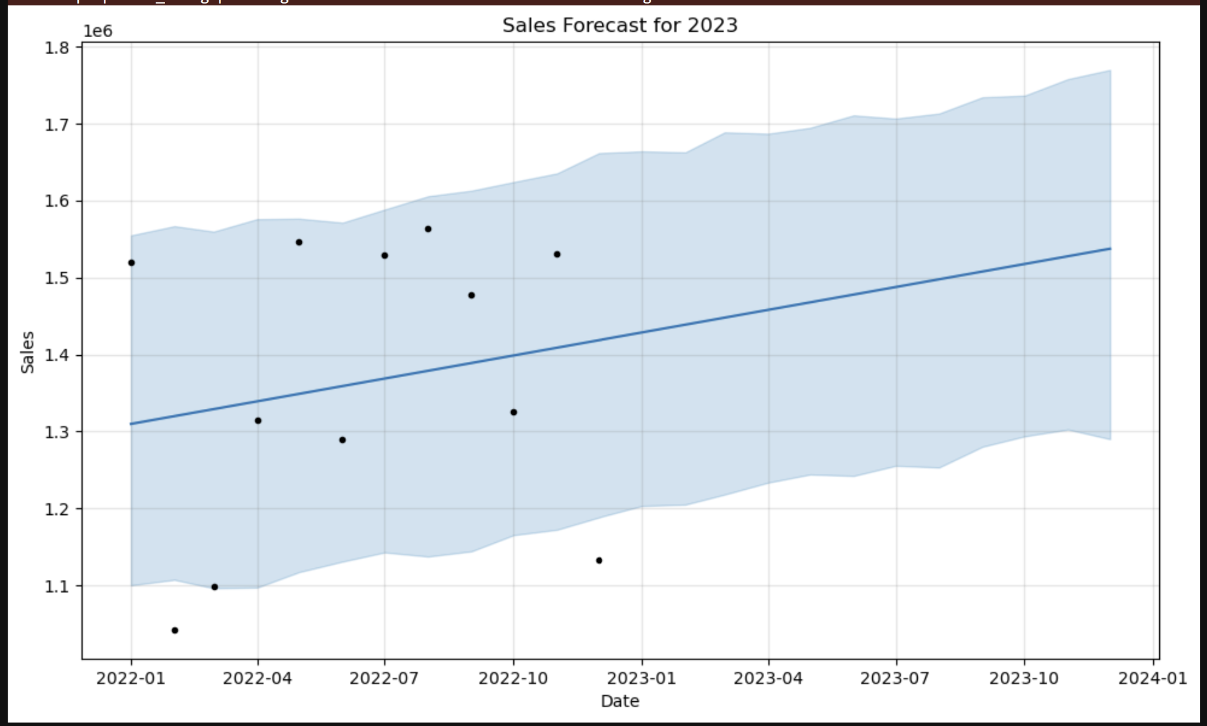
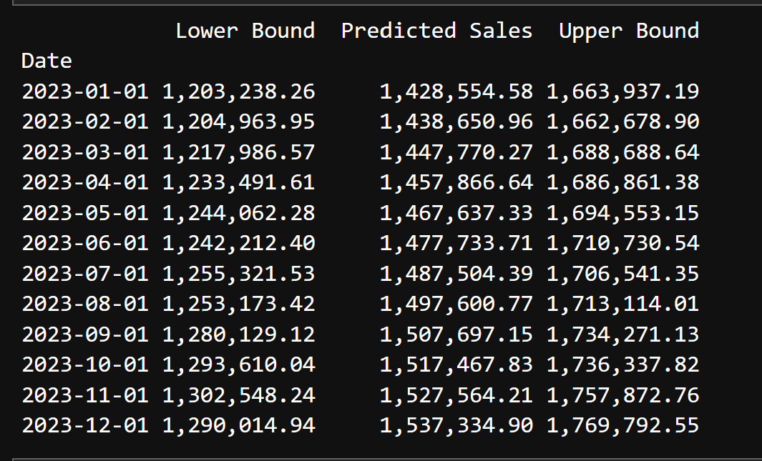
Sales Forecast Using Prophet

Slide 4
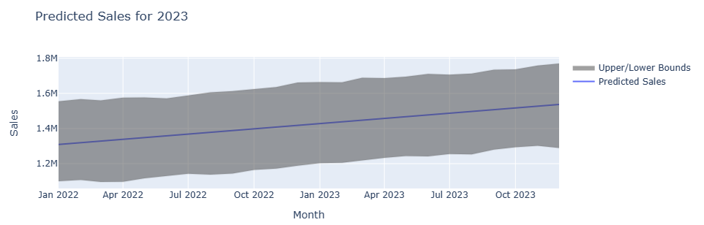
Sales Forecast Using Prophet

Slide 5
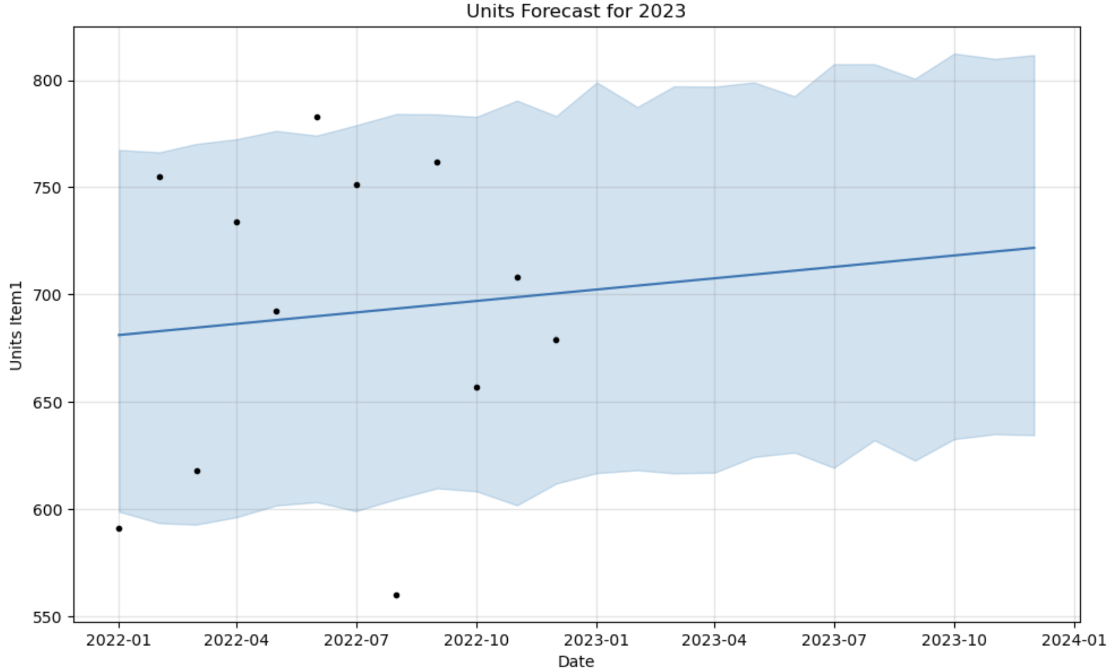
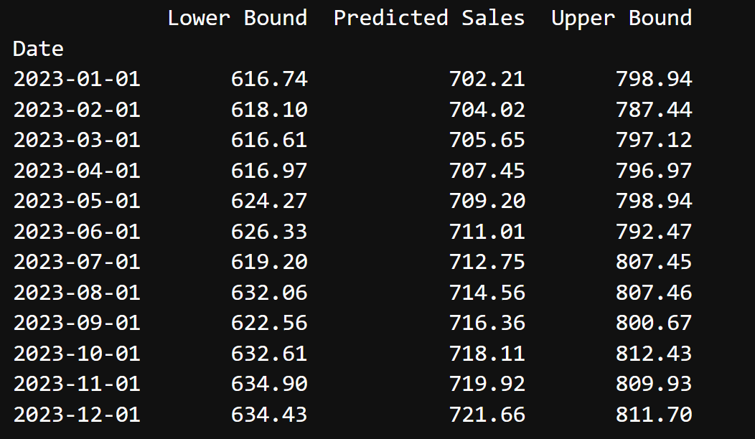
Unit Forecasting Using Prophet
Item 1

Slide 6
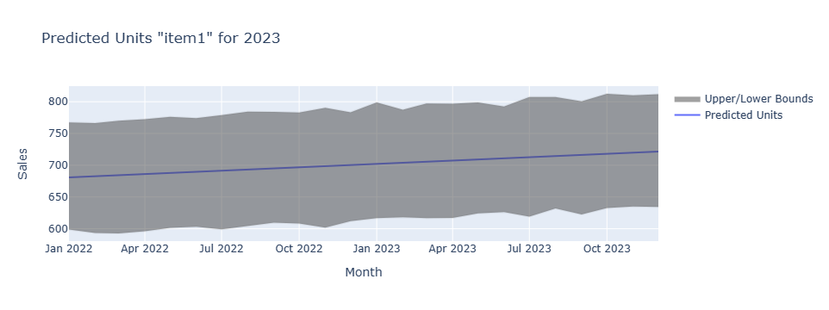
Unit Forecasting Using Prophet
Item 1

Slide 7
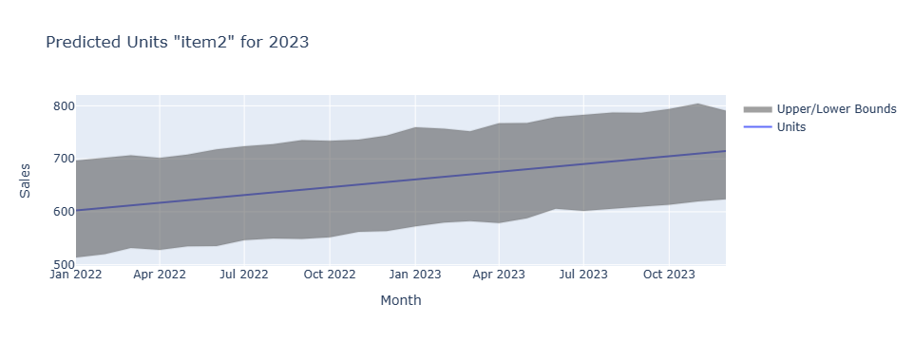
Unit Forecasting Using Prophet
Item 2

Slide 8
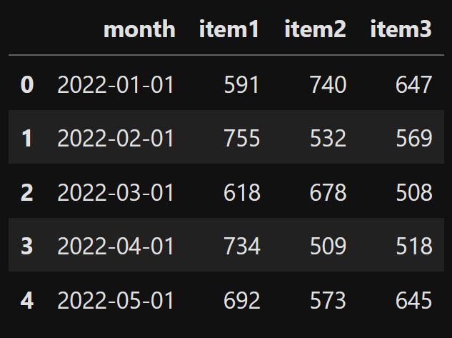
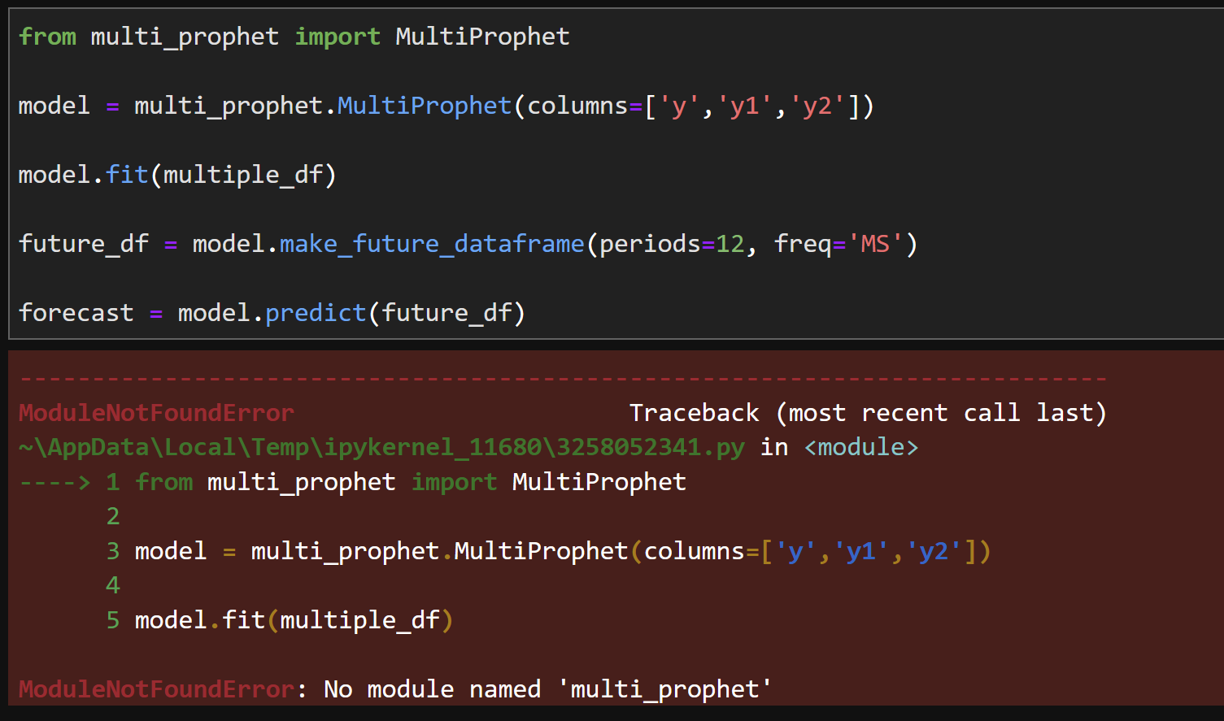
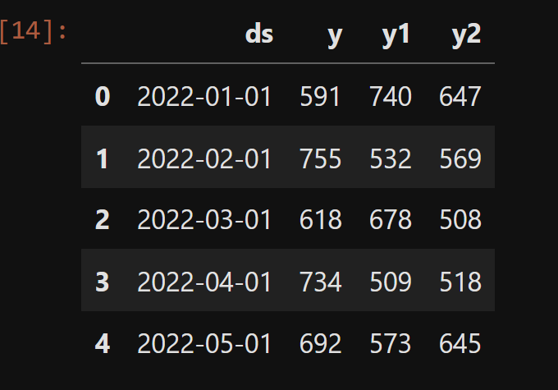
Multi Prophet Forecasting - Failed

Slide 9
Next Steps
Complete the Multi-Prophet forecasting
Combine item forecasting into 1 data frame
Create automated shipping replenishment
Create “Title audits”
Show this to my boss to get a promotion
Create a “backtesting” strategy

Slide 10
Questions?

